Slide 1
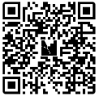
Latino Leadership
Council
Community Impact & Data Review
"Being a single mom can be really hard and lonely, but LLC has shown me that I’m not alone and there are people who can help me when times are tough. I look forward to learning more and getting my family more involved in the community."
LLC Client
Notes:
Syrina introduce - at placer and on the board for almost 2 years
Crys introduce
Syrina: House keeping Ment QR code & Quotes
Crystal: what we are talking about and introduce next slide
My work with the LLC encompasses using a lot of our data and numbers to track out impact. This could entail types of services, count of services, program sessions, as well as tracking how many community members we have working with us who have been committed to their and their families' growth and wellbeing.
We are here today to talk to you all about the impact the LLC has had on the community over the last few years.
But in order for us to do that, I do need to give you a bit of the background of Latinos in Placer County.
Mention QR code for questions and quotes throughout the survey

Slide 2
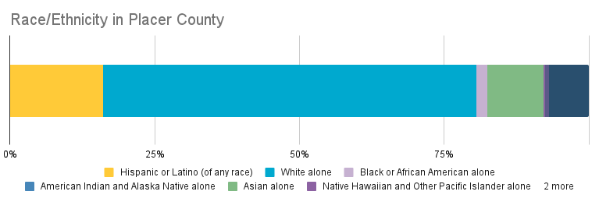
Race/Ethnicity of
Placer County
Latino residents (of any race) make up an estimated 16% of the population in Placer County and over 20% of the population in the SACOG boundary.
Source: SBC, 2023 Census Bureau
Notes:
The following three slides include charts provided by the Sierra Business Council. This chart reveals that Hispanic or Latino residents (of any race) make up an estimated 16% of the population in Placer County and make up over 1 out of 5 people in the SACOG boundary. This is the largest ethnic/racial subgroup in Placer County, and it has grown by 6.5% since 2010.
Itʼs also important to note that Latinos even had a net undercount rate of 5% in the 2020 Census. This margin of error is likely due to confusion about the separate questions regarding race and ethnicity, low literacy rates, language and technological barriers that make it hard to survey, and track that data.
This is extremely important since federal and local government analyze census data to allocate community resources. The census determines the distribution for billions of federal funding for schools, roads, and countless vital programs.
​

Slide 3
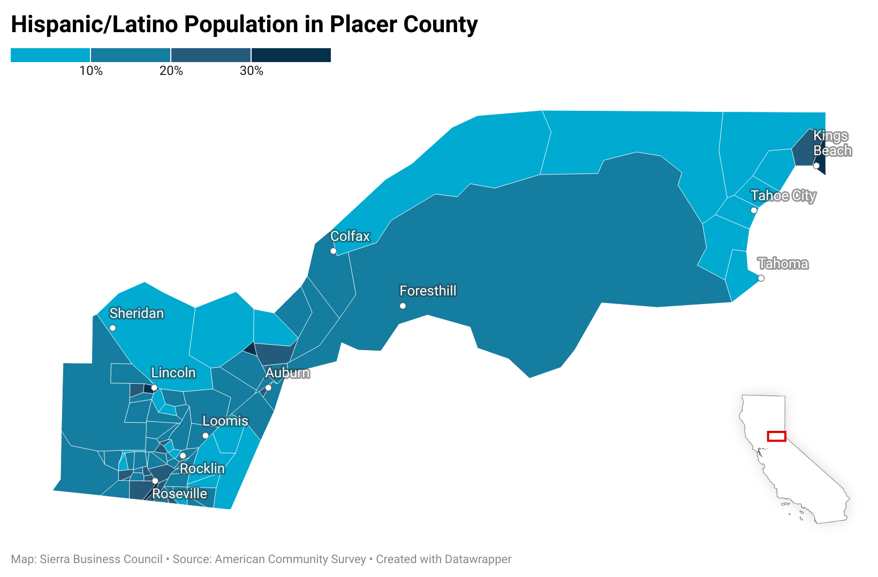
Hispanic/Latino Population in
Placer County​
Source: SBC, American Community Survey
Notes:
This following slide include a heat map, showing the density of the Latino population by census tract.
If you take a look at the top, you will see the densest areas of latinos are revealed in dark blue. These areas areKings Beach, North Auburn, Roseville, and Lincoln, which have the highest populations, following with Rocklin. These are LLC’s primary service areas, excluding Kings Beach.

Slide 4
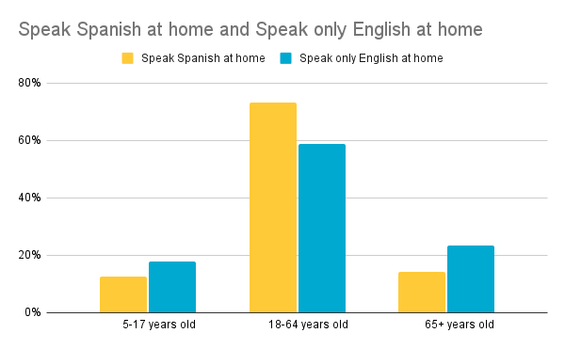
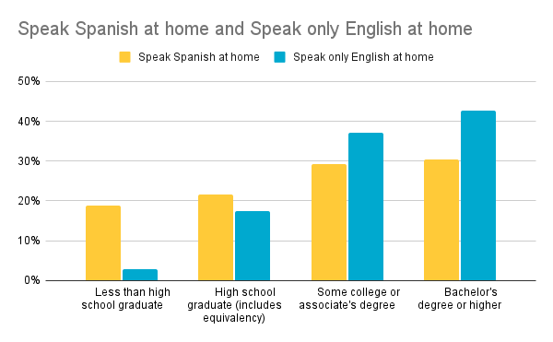
Spanish Speaking Population:
Age & Education
Over 70% of Latinos who only speak Spanish at home are 18-64 years old.
Comparing education levels, those who only speak English at home are more likely to obtain some college or higher education.
Source: SBC, 2023 Census Bureau
Notes:
The following Bar Charts, compare monolingual spanish and monolingual english speaking populations. The graph to the left compares the populations according to age, while the one on your right compares educational attainment.
Please take a few moments to examine the chart, and see what’s coming to your head.
Of those who reported speaking only spanish at home, 13% were under age 18, 73% are in the working age demographic, and 14% were 65 years or older.
​Of Latinos who speak Spanish at home and are 25 years and up, an estimated 1 out of 5 people have less than a high school degree. Those who only speak English at home are more likely to obtain some college or higher education, visualized on your right

Slide 5
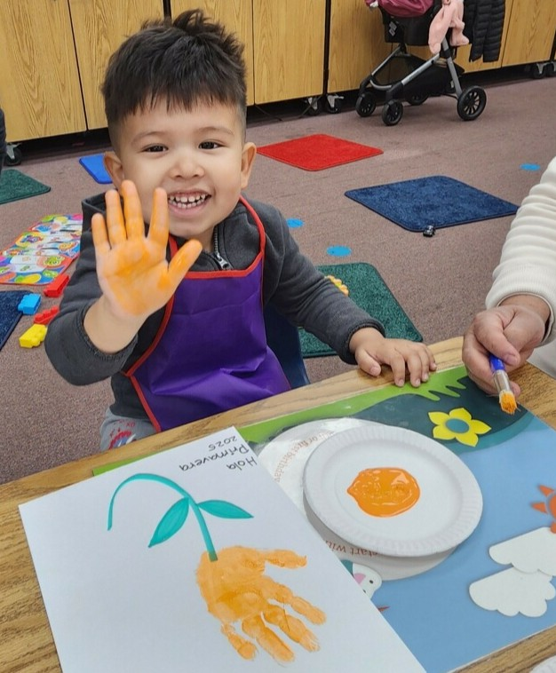
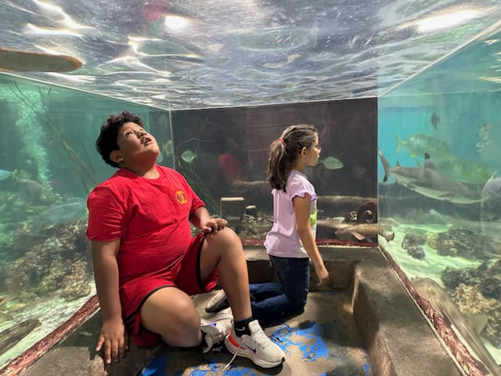
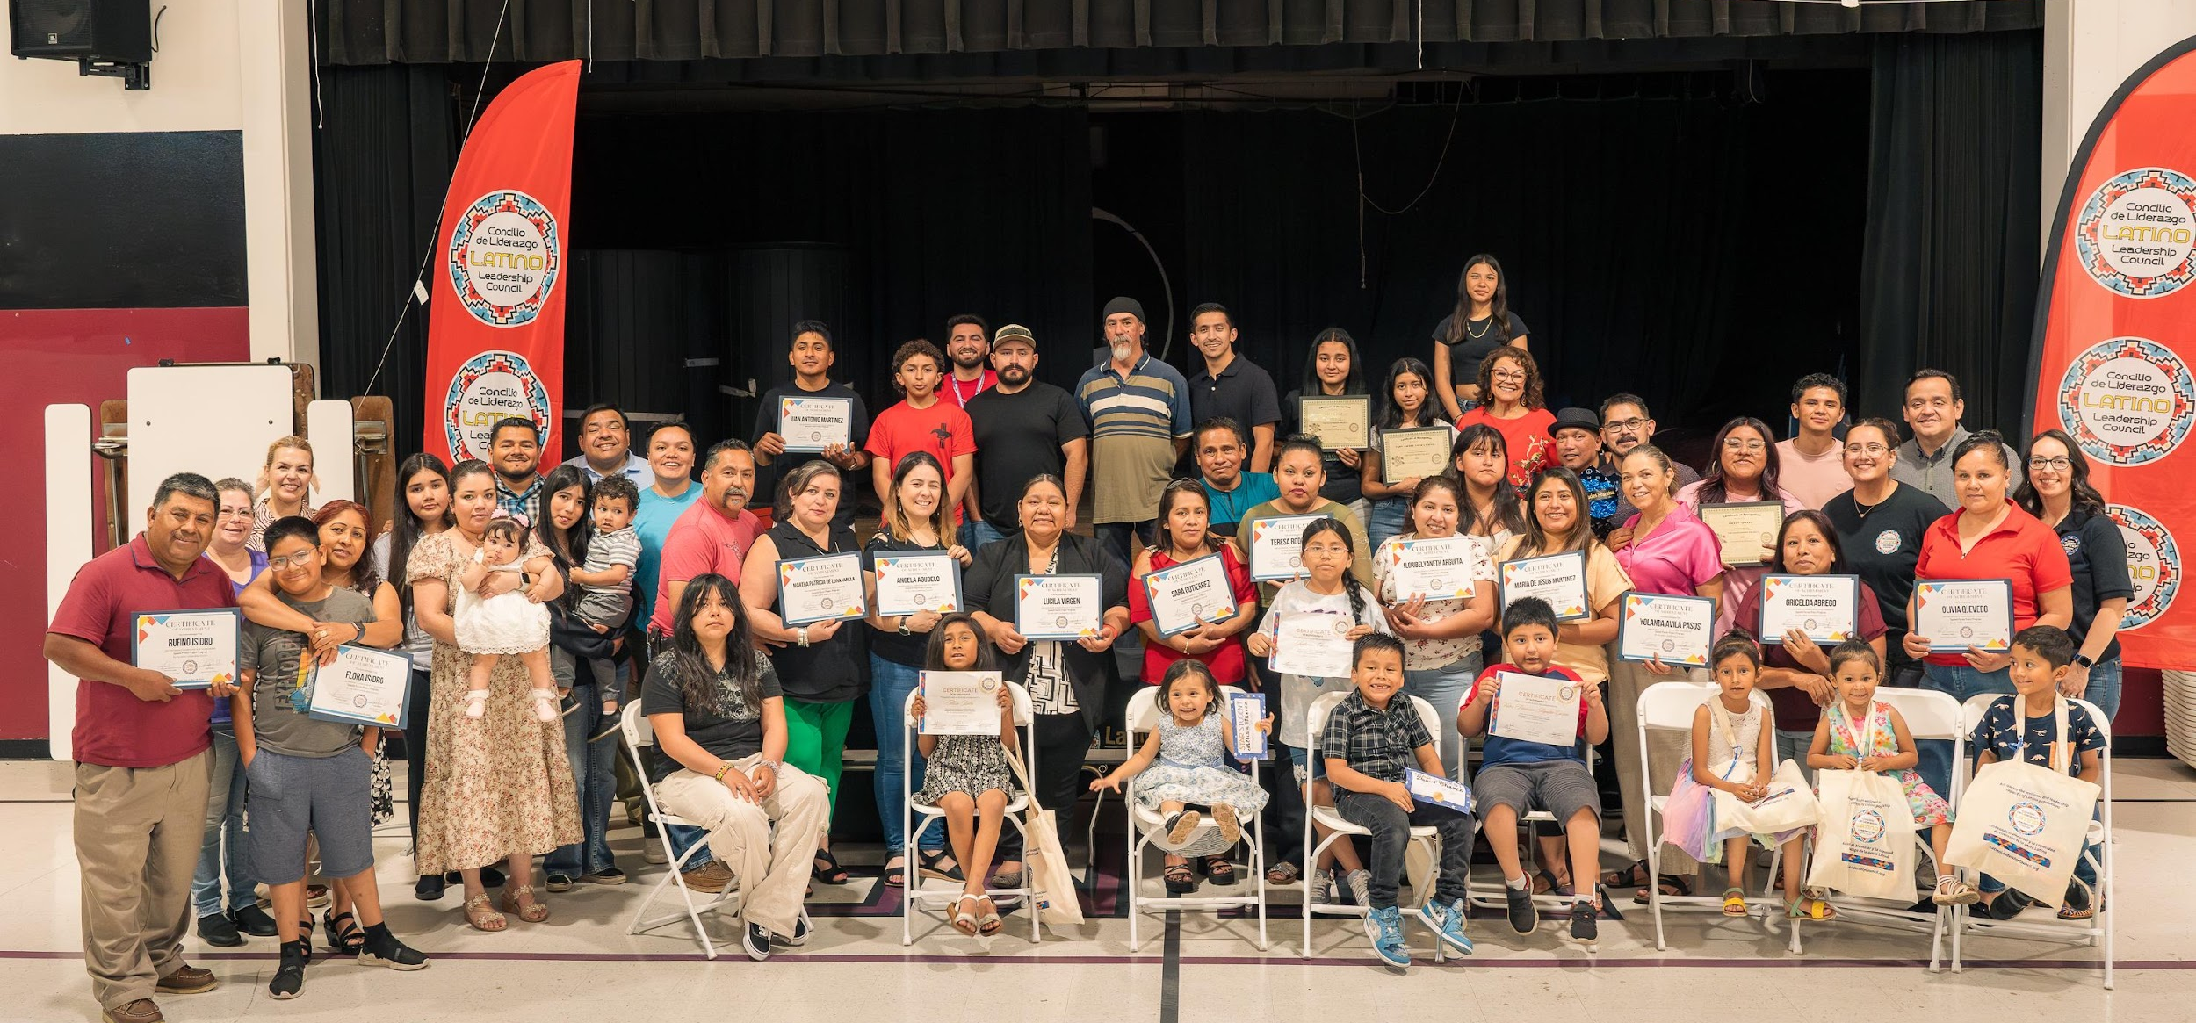
Programs:
2025 Enrollment:
Mami y Yo: 32
Youth Groups: 73
Parent Project: 52
Superación Personal &
Rincón de Las Comadres: 131
Mis Cuates: 17
"Superación Personal helped me grow into the person I am now. I felt heard, empowered, and like I mattered. This motivated me to give that same feeling back to the community that helped uplift me. Without the LLC, I never would have gained the necessary confidence to start my own workshop."
Superación Client
Notes:
No we’ll do a short review of each program offered by the LLC and its purpose. And what we currently have listed on this slide are the enrollment numbers for each program to date.
To start, Mami y Yo was created in partnership with First 5 Placer, and translates to “Mommy & me”. This program offers a safe space for parents of children age 0-5 to connect with others and gain knowledge about childhood development. A public health nurse and other specialists join on occasion to answer health-related questions.
Our youth groups include Entre Amigos, Entre Chiquillos, and the Youth Ambassadors. This translates to “Between friends” and “Between kids” and these programs are safe spaces for Latinx children and youth to engage in personal development opportunities, receive 1:1 mentorship, and learn about their culture with in-person and virtual activities.
The Parent Project is a 16-week course that teaches parents of children up to age 18 about raising them in a bicultural environment. Lessons include healthy relationships, gangs, alcohol, and other challenges
Superacion Personal translates to “personal improvement” in English and this program is an online support group that provides a safe space for clients to meet & discuss challenges and receive support to overcome them. Meeting topics vary and could address cultural and family dynamics, stress and anxiety, etc. and resources on how to work through the issues.
Rincon de las comadres translates to “Corner of the comadres” (comadre is a term used describe close female friends, like a sister) and this is a crafting program that brings Latinas together to share and learn from each other's skills and knowledge and to help them excel in their personal and professional lives. One of the purposes of the program is to preserve Latino crafts and encourage participants to share the cultural experience with the next generation.
Mis Cuates which translates to “my buddies” is an in-Spanish weekly support group for men that addresses cultural and family dynamics, stress and anxiety and supports on how to work through issues. It allows the Latino community to have a safe space to express their unique experiences. This program also directly addresses the stigma machismo in the Latin culture. Machismo is a cultural norm in which men feel that they have to always be strong, can’t share the feelings, and can never ask for help. This program is breaking the status quo and positively impacting Latino men in the community.

Slide 6
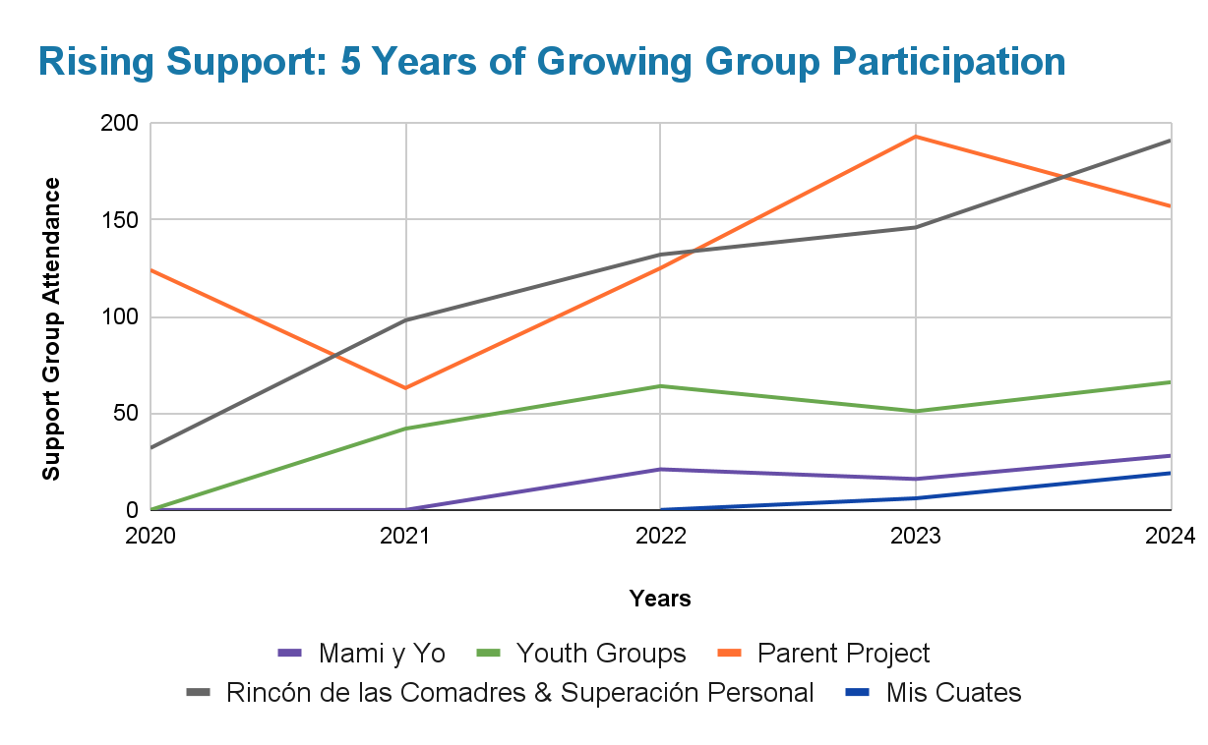
Programs & Services:
2020-2024
Notes:
Taking a look at the graph here, we can see since 2020 there has been an increase in client enrollment and participation in the support groups offered by LLC. The highest enrollment and participation among all programs has come from the Parent Project and Rincon de las Comadres and Superación Personal.
The parent project (represented by the orange line) has had an average of 116 participants since 2020, with a peak of 193 participants in 2023.
Between both Rincon de las Comadres and Superacion Personal (represented by the black line), there has been an average of 121 participants with 2024 having the highest enrollment between both programs (191 participants)
As a note, with the consistent impact and success of LLC over the past 5 years, the capacity for data collection and impact analysis has increased. The data represented here is due in large part to Crystal’s statistical analysis. However, please note that prior to 2022 data is likely underreported and more clients were likely reached but not formally captured in the data

Slide 7
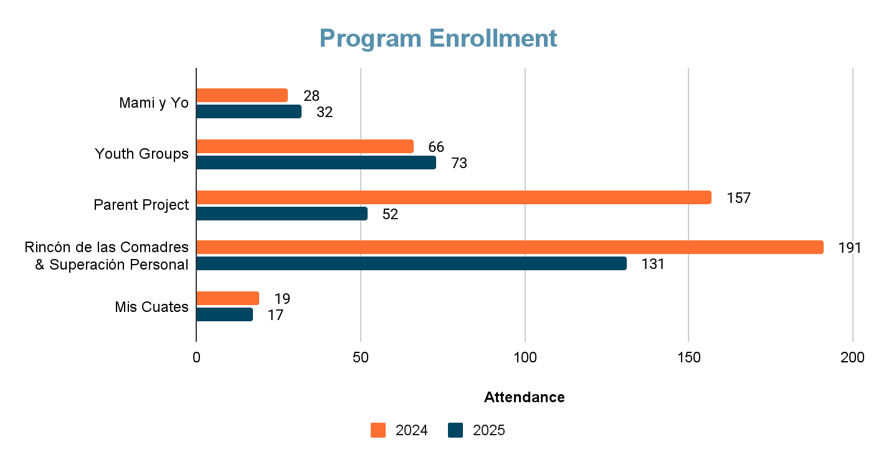
Midyear Enrollment Comparison
Notes:
Taking a look at the midyear enrollment, this chart captures the total program participation for 2024 (in orange) and the enrollment from January of this year to August (2025 in navy blue). Reviewing the bar chart, we can see 3 of our 5 programs are expected to surpass or have already surpassed the enrollment and participation for 2024. For example:
Mami y Yo is at 32 participants already this year, compared to 28 for all of 2024
Our youth groups have passed 2024’s enrollment with 73 already enrolled for this year
Mis cuates has 17 participants on the year so far, and they had 19 total participants for all of 2024
In all, these programs have been reaching more people in the community showing the consistency and impact of the LLC’s work.

Slide 8
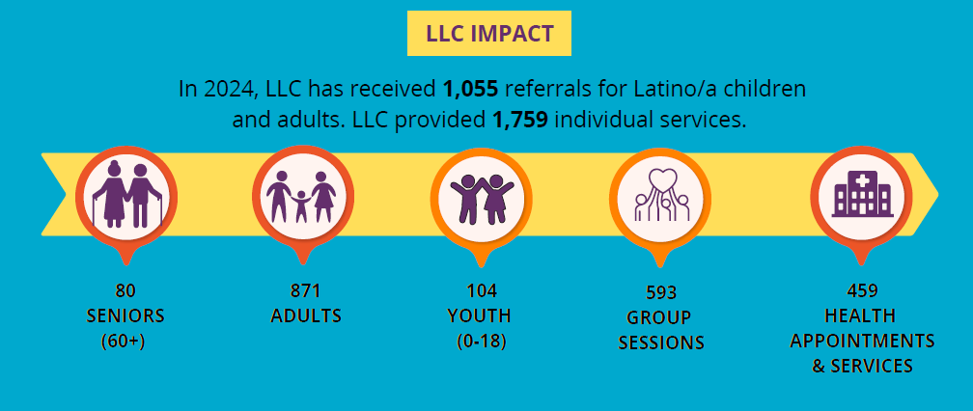
2024 Community Impact Report
“I love participating in Entre Amigos because we always have a great time together and it reminds me of being in Mexico with my family. Getting involved has allowed me to meet other Latino [youth] and helped me to realize my family and I aren’t the only Latinos in this community.
I am so grateful for the Entre Amigos program.”
Ayari, Entre Amigos
Notes:
Now let’s take a moment to focus on the 2024 Community Impact Report, and more importantly the people behind the numbers.
In 2024, LLC received 1,055 referrals from across Placer & Sacramento county. That’s nearly 90 clients each month reaching out or being referred for support.
Of those, the majority, about 62 percent, were working age adults. We also saw 80 seniors and over 100 youth referred to our services. This clearly tells us, our community is reaching out across every age group.

Slide 9
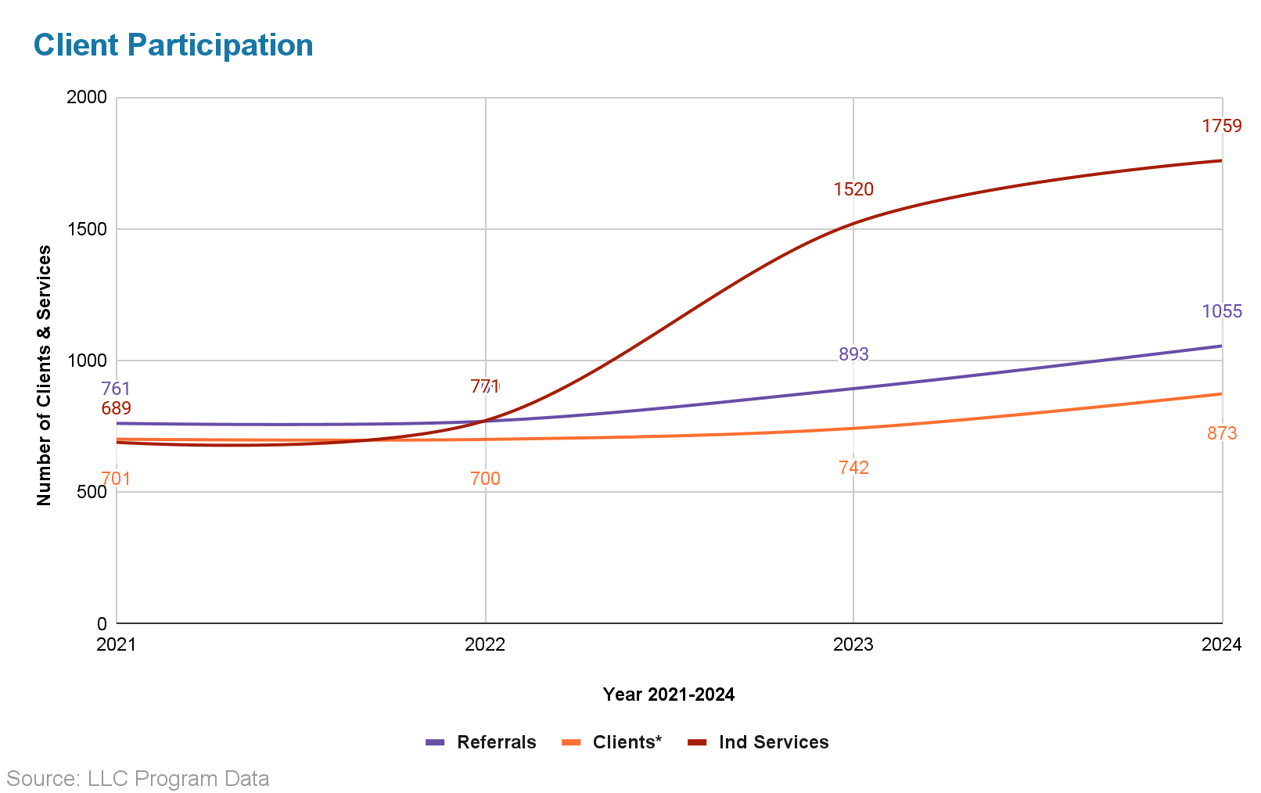
2024 Community Impact Report
In 2021, LLC provided 761 referrals resulting in 689 individual services.
By 2024, referrals increased to 1,055, and individual services doubled to 1,759.
Notes:
From our total 2024 referrals, 873 people accepted services. That’s a 25% increase compared to 2021.
This is represented by the orange line on this Client Participation graph.
To us, that’s more than growth, it is a reflection of the growing trust in LLC from the Latino community.
9 out of 10 of these clients speak only spanish, and about 2/3rd identified as women.
Another small but important 1%, only spoke an indigenous language, highlighting the need for culturally rooted support.
Now I want to draw your attention to the dip in 2021 & 2022. Here LLC had limited capacity to track and pull data.
But since 2022, we have strengthened that capacity, and the jump in growth you see reflect community need & LLC’s growing ability to respond.
In 2021, we provided just under 700 individual services. But just 3 years later that # more than doubled to over 1,700, revealed by the red line.
Although, I may be thawing a lot of data at you all, we must remind ourselves that behind every data point is a person, a mother, a grandparent, or teen saying yes to support and finding it with LLC.

Slide 10
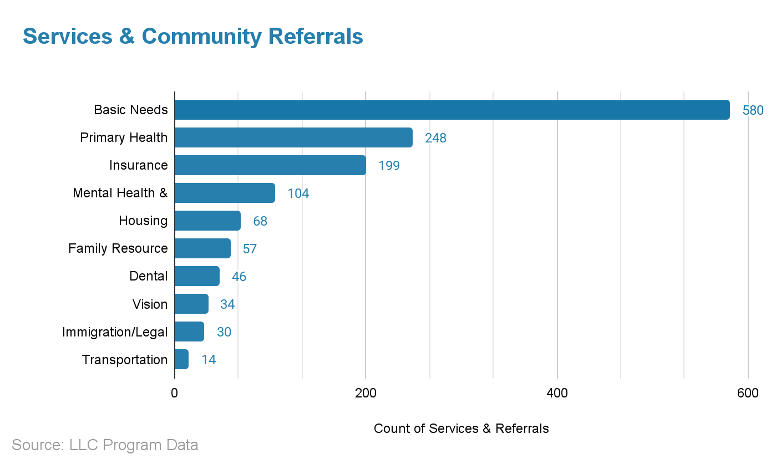
2024 Community Impact Report
In 2024, LLC provided:
1,380 total external services & community referrals*
  ~ 42% of service requests are Basic Need support
  ~ 18% are Primary Health Care/Clinics
  ~ 8% Mental Health & Therapy Support
Notes:
This next slide highlights a portion of community needs supported by LLC 2024. We conducted over 1300 external services & referrals.
Each of our clients are assigned a Promotor who provides direct service support and provides a warm hand-off to partnering organizations..
It is important to note that this number doesn’t include home visits, phone calls, or other direct support provided by our Promotores. These numbers just reflect a portion of the day to day care we offer.
As you can see, basic needs make up the highest community need, accounting for over 40%. Take a second to process that data point.
That’s at least 580 of your peers in need to access to things like food, shelter, clothing, diapers or hygiene products.
The next largest area of support is primary health care, with nearly 250 people referred or accompanied to medical appointments. Many of these were scheduled and supported by our team of Promotores who build trust and often quite literally walk beside clients as they navigate the health care system.
Another major area is health insurance support, with nearly 200 referrals & services. Our Promotores help clients understand, enroll, or access their insurance. For many, especially the monolingual spanish speaking community, insurance systems can feel intimidating and inaccessible. Our Promoters play a vital role in bridging that gap.
On average 1 in 3 of LLC clients do not have nor qualify for health insurance. And with recent changes to Medi-cal, we expect this number to rise. These shifts will have a severe impact on clients who currently rely on Medi-cal for prenatal care, chronic illness management, prescription medication, and more. For the majority of our community, losing that access could lead to serious long-term consequences, not just in health but overall stability.
Regardless of your background or native language, how many of you can remember a time where even if you didn’t realize in the moment, could have benefited from the support of a promotore.
Now let’s take that personal moment, and really think about the impact on these hundred of families receiving LLC support.
That is a significant number of lives being positively impacted by our organization.

Slide 11
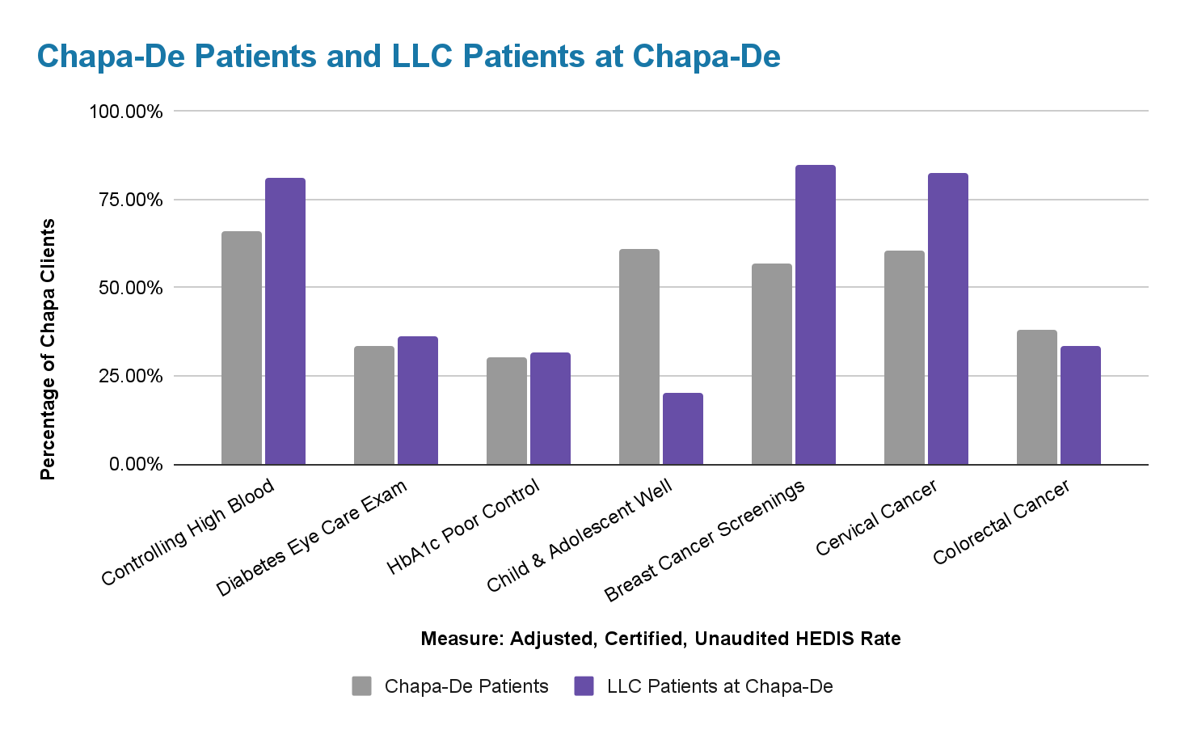
Healthcare Effectiveness Data & Information Set (HEDIS) 2024
T
Notes:
Now we’ll take a look at the Healthcare Effectiveness Data & Information Set (also known as HEDIS)
This data is a standardized set of healthcare quality measures used to evaluate and compare the performance of healthcare organizations. It provides a framework for measuring and reporting on key aspects of healthcare quality, such as preventive care, chronic disease management, and access to care.
The data here was collected by Chapa De in 2024 regarding LLC clients that were referred there for care and represents certain preventive and primary care/disease management metrics
This data shows that LLC clients scored healthier in 4 of the 7 metrics measured compared to the overall patient population at Chapa-De.
This equates to an average of 58% of LLC clients referred to Chapa De participating in positive health behaviors.
This positive participation in health behavior can be attributed to LLC's Promotoras and the rapoport they build with clients, in not only connecting them to these services but by building trust and ensuring their clients develop skills to be proactive in their wellness.
While LLC clients did well in a majority of the metrics, the remaining metric’s scores (child and adolescent wellbeing and colorectal cancer), serve as a guide to assist LLC in identifying areas of improvement

Slide 12
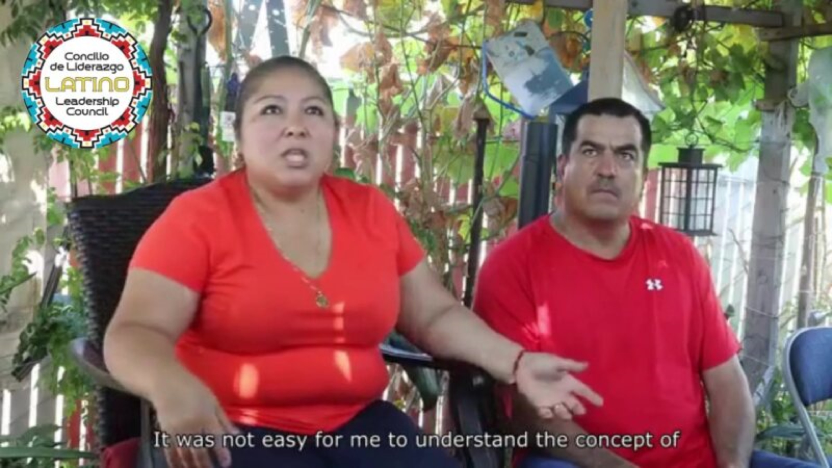
Client Story
Notes:
Syrina: Now we’ll share a short video showing a client’s testimony regarding LLC services. Please note their names have been redacted for privacy purposes

Slide 13
Thank you & Contact
Syrina Vasquez MPH, Epidemiologist
Placer County Public Health
Latino Leadership Council, Board Member
SyrinaV@LatinoLeadershipCouncil.org
Crystal Lopez-Franco, Outreach Coordinator
Latino Leadership Council
CrystalF@LatinoLeadershipCouncil.org
LinkedIn: www.linkedin.com/in/crystal-lf
Questions?
“The LLC has helped me with services to heal from my childhood trauma. My Promotor, was supportive throughout the whole process. I learned many skills in therapy and attending Mis Cuates. I am able to build up my life without self-sabotaging”
Mis Cuates Client
Notes:
Syrina starts the thank you

